Slide 1

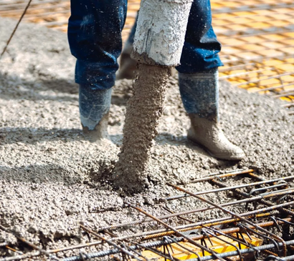
CONCRETE STRENGTH PREDICTION USING MACHINE LEARNING
Presented by
Tasmia Sultana Juthy(2004106)
Laila Sharmin Sukti (2004112)
Sabbir Mahamud (2004118)
Abrar Faiaz (2004124)
Alphy Shaharin Tamim (2004130)
Group: 3

Slide 2
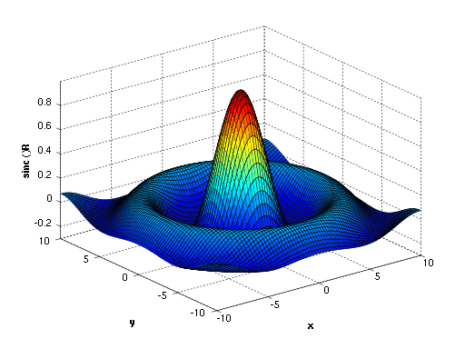




INDEX
Introduction &Objective
Findings
Parameter list(input output)
Limitations

Slide 3

OBJECTIVE
CORRELATION PLOT
CORRELATION HEATMAP PLOT
TRAIN TEST SET SPLIT
REGRESSION ANALYSIS
TAKING INPUT FROM USER TO PREDICT

Slide 4

NECESSARY FORMULAE
LOWER OUTLIER = Q1 - (1.5 * IQR)
HIGHER OUTLIER = Q3 + (1.5 * IQR)
SSE = SUM((Y_TEST - Y_PRED).^2)
SST = SUM((Y_TEST - MEAN(Y_TEST)).^2)
R_SQUARED_LINREG = 1 - (SSE / SST)
MAE_LINREG = MEAN(ABS(Y_PRED - Y_TEST))
MSE_LINREG = MEAN((Y_PRED - Y_TEST).^2)

Slide 5
FINDINGS
Correlation Plot
It is the graphical representation of the correlation between multiple
variables in a dataset.
Correlation Heatmap
Here, each cell in the heatmap represents the correlation coefficient
between two variables.
Gaussian Process Regression
It is particularly useful when dealing with small to medium sized data
sets or when need to incorporate uncertainty into predictions
Outliers
An outlier is a data point that is significantly different from the rest
of the data.

Slide 6
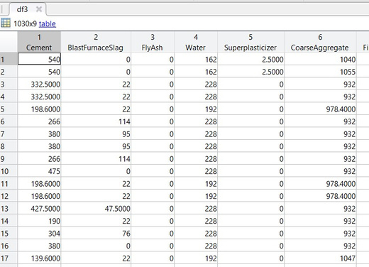
LIMITATIONS
Efficiency and accuracy is good enough for our datasets as we work
for large number of datasets. It can
vary for other datasets
If any new ingredient is added, our model will not work.

Slide 7
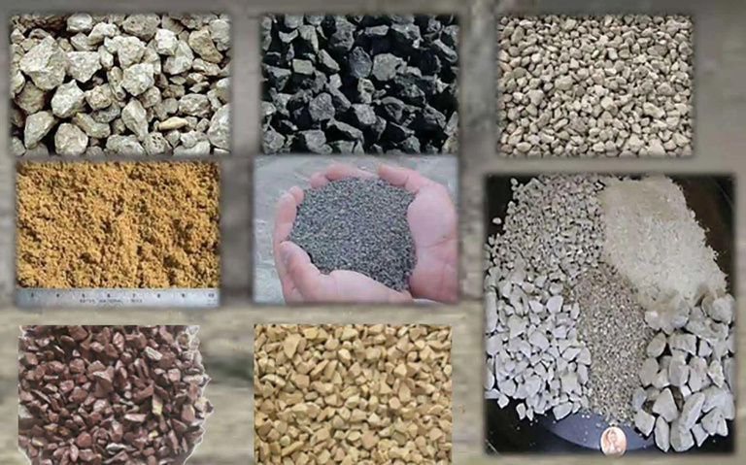
INGREDIENTS IN DATASET
CEMENT
BLUST FURNACE SLAG
FLYASH
WATER
SUPER PLASTICIZER
COARSE AGGREGATE
FINE AGGREGATE
AGE
STRENGTH
BUSINESS COMPETITION
Apply page animations and transitions to your Canva presentation to emphasize ideas and make them even more memorable.

Slide 8
PARAMETER LIST
INPUT PARAMETER:
input_age = input('Enter Age value: ');
user_input = table(input_cement,
input_blast_furnace_slag, input_fly_ash, input_water, ...
input_superplasticizer, input_coarse_aggregate, input_fine_aggregate, input_age);
user_input_matrix = table2array(user_input);
predicted_strength = predict(mdl, user_input_matrix);
fprintf('Predicted Strength: %.4f\n', predicted_strength);
input_cement = input('Enter Cement value: ');
input_blast_furnace_slag = input('Enter Blast Furnace Slag value: ');
input_fly_ash = input('Enter Fly Ash value: ');
input_water = input('Enter Water value: ');
input_superplasticizer = input('Enter Superplasticizer value: ');
input_coarse_aggregate = input('Enter Coarse Aggregate value: ');
input_fine_aggregate = input('Enter Fine Aggregate value: ');

Slide 9
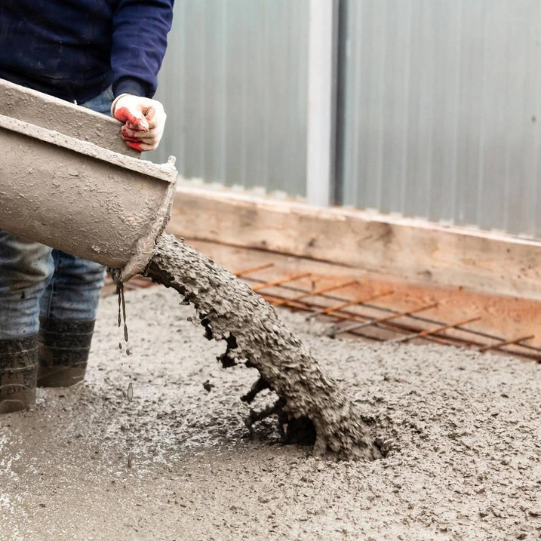
REQUIREMENTS
MATLAB
MACHINE LEARNING TOOLBOX
ECONOMETRICS TOOLBOX

Slide 10
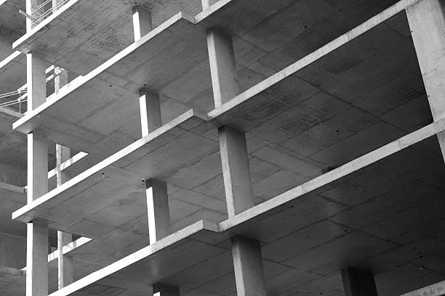
THANK YOU

